Slide 1
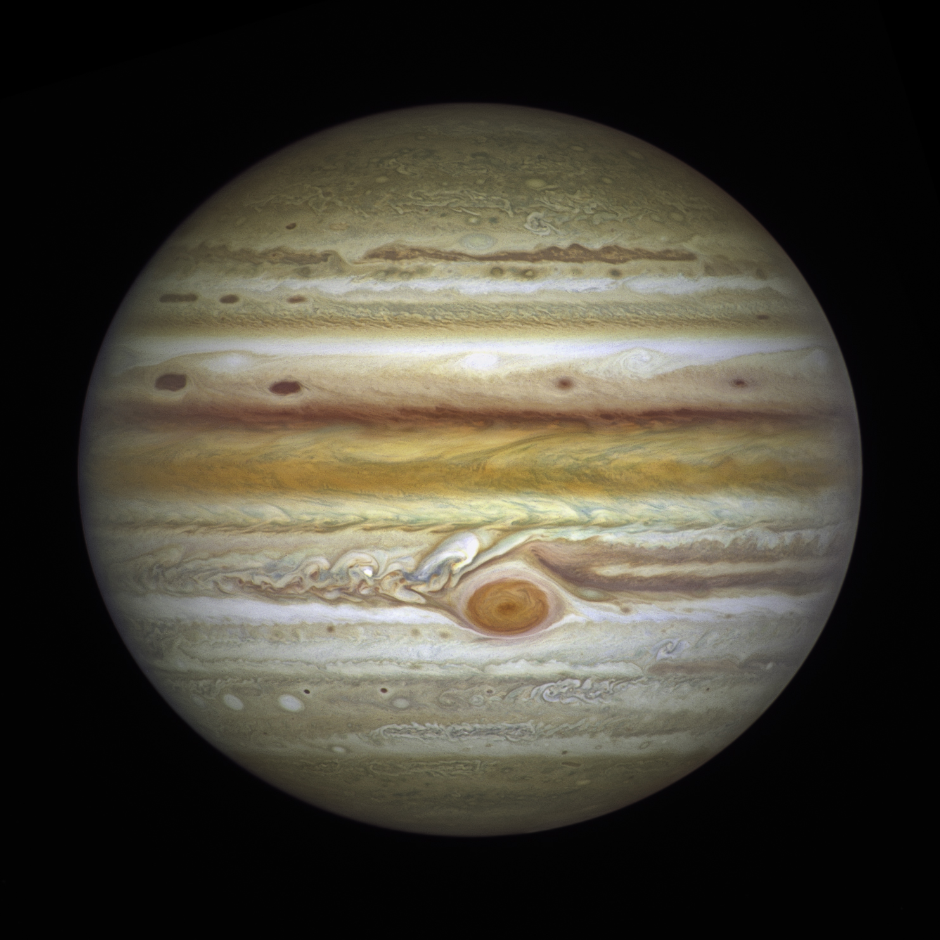
Notes:
https://www.nasa.gov/feature/goddard/2021/hubbles-grand-tour-of-the-outer-solar-system

Slide 2
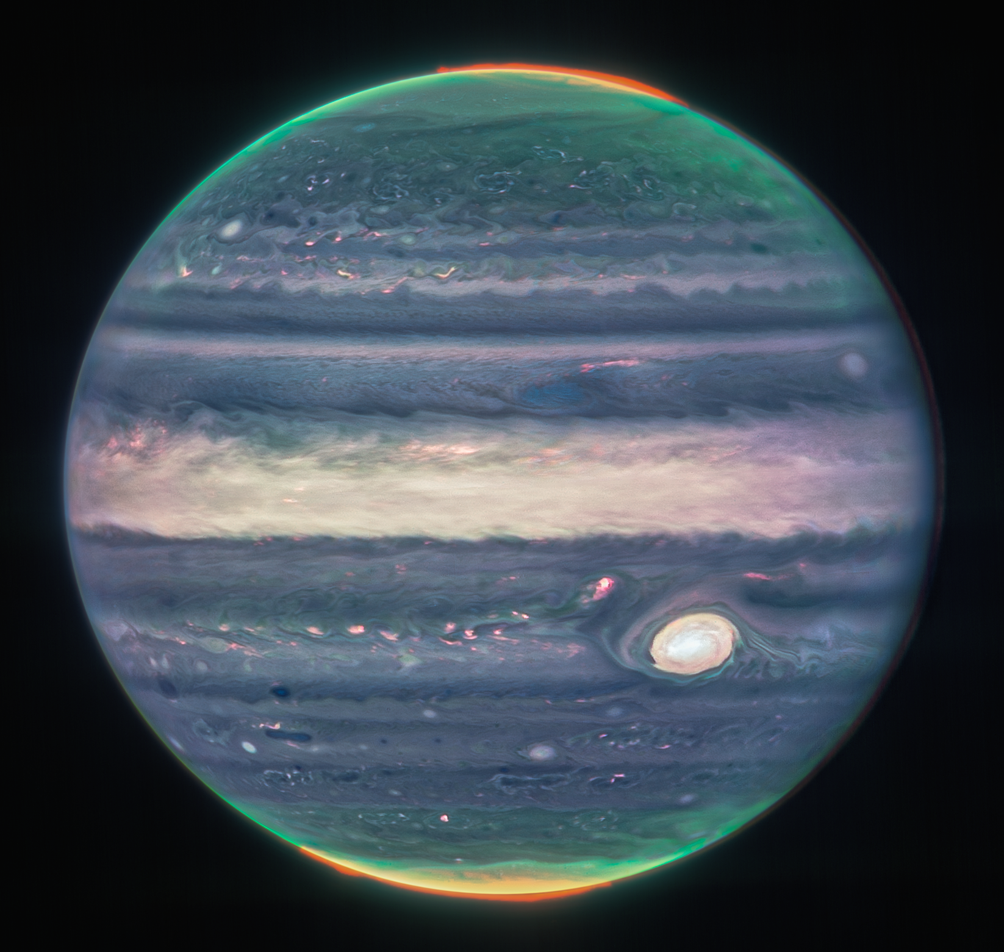
Notes:
https://blogs.nasa.gov/webb/2022/08/22/webbs-jupiter-images-showcase-auroras-hazes/?utm_source=TWITTER&utm_medium=NASAWebb&utm_campaign=NASASocial&linkId=178177184

Slide 3
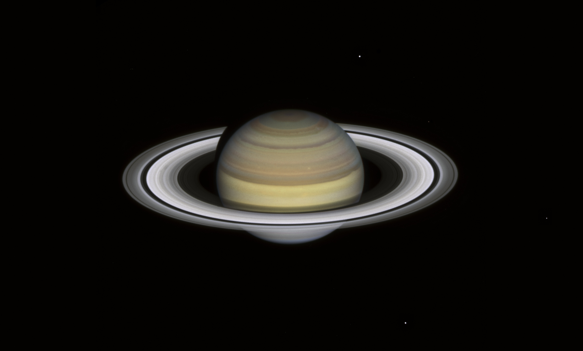
Notes:
https://www.nasa.gov/feature/goddard/2021/hubbles-grand-tour-of-the-outer-solar-system

Slide 4
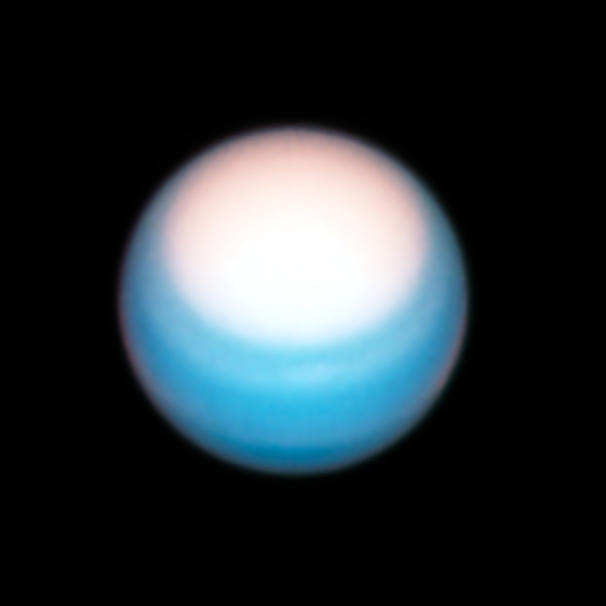
Notes:
https://www.nasa.gov/feature/goddard/2021/hubbles-grand-tour-of-the-outer-solar-system

Slide 5
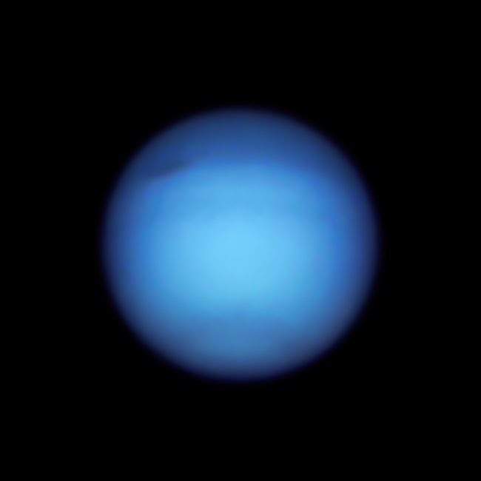
Notes:
https://www.nasa.gov/feature/goddard/2021/hubbles-grand-tour-of-the-outer-solar-system

Slide 6
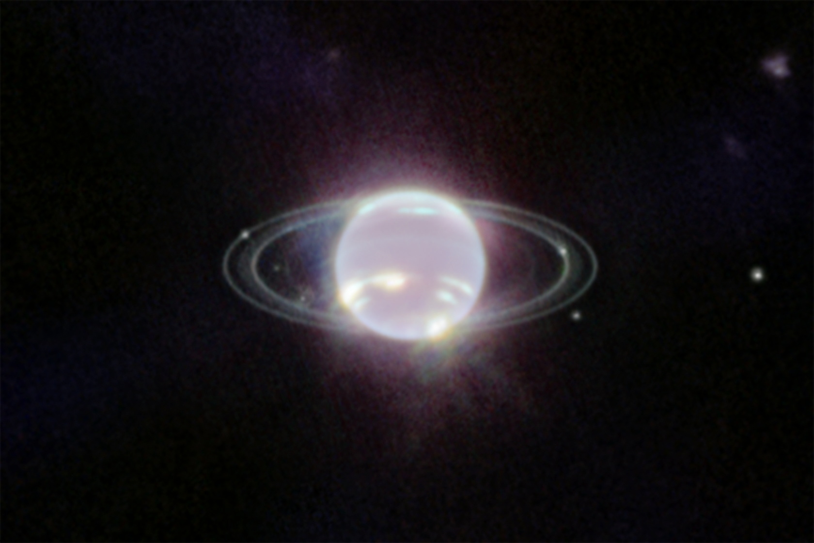
Notes:
https://www.nasa.gov/feature/goddard/2022/new-webb-image-captures-clearest-view-of-neptune-s-rings-in-decades

Slide 7
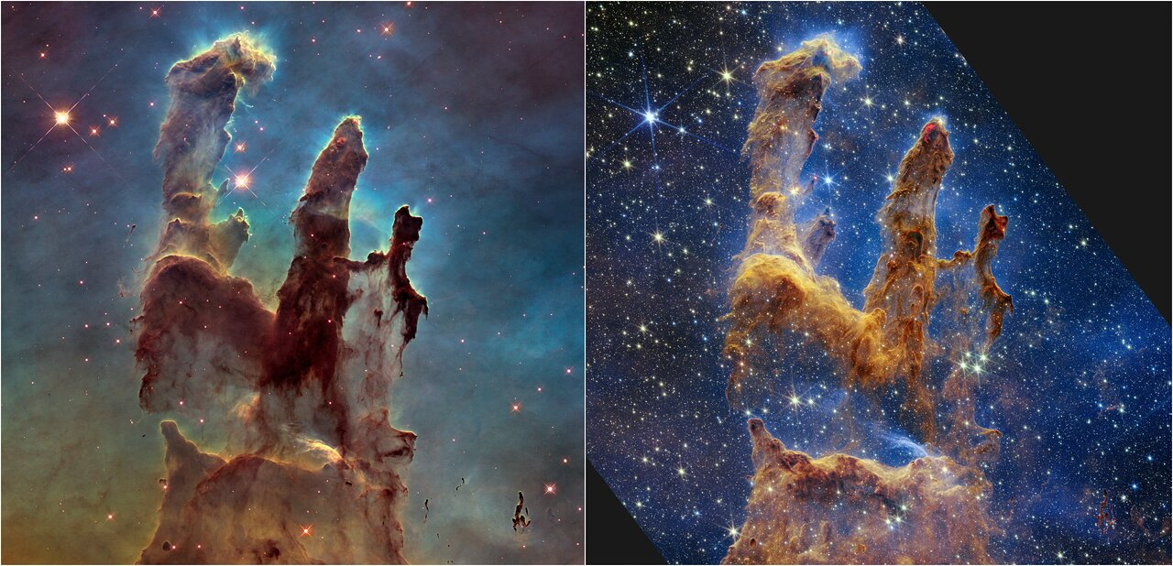
Notes:
https://www.nasa.gov/feature/goddard/2022/nasa-s-webb-takes-star-filled-portrait-of-pillars-of-creation

Slide 8
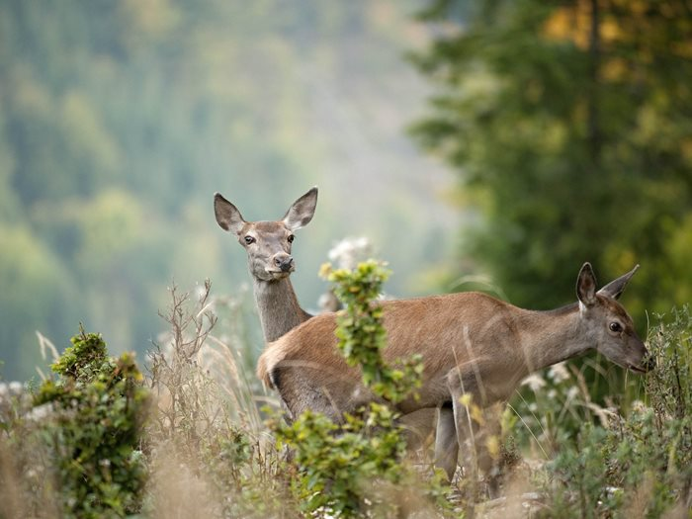
Notes:
https://www.myslivost.cz/Casopis-Myslivost/Myslivost/2023/Prosinec-2023/Jeleni-holou-zver-lovte-s-rozumem

Slide 9
https://www.nasa.gov/feature/goddard/2021/hubbles-grand-tour-of-the-outer-solar-system
https://blogs.nasa.gov/webb/2022/08/22/webbs-jupiter-images-showcase-auroras-hazes/?utm_source=TWITTER&utm_medium=NASAWebb&utm_campaign=NASASocial&linkId=178177184
https://www.nasa.gov/feature/goddard/2022/new-webb-image-captures-clearest-view-of-neptune-s-rings-in-decades
https://www.nasa.gov/feature/goddard/2022/nasa-s-webb-takes-star-filled-portrait-of-pillars-of-creation
https://www.myslivost.cz/Casopis-Myslivost/Myslivost/2023/Prosinec-2023/Jeleni-holou-zver-lovte-s-rozumem

